Slide 1

Bedding Bathing & Yonder (BBY)
Data Analytics
Marketing Department
An American merchandise retail chain
Notes:
Welcome to this presentation which is a summary of Data analytics performed using R on BBY.
I am Ohm Kundurthy and I will be talking you through the analytics performed on their data to help their Marketing dept.

Slide 2
Agenda
Objectives
Data Summary
Data Visualization
First Fit
Parsimonious Fit
What insights benefit Marketing ?
Top Prospects
What Next ?
Notes:
Our Agenda is outlined here,
Objectives followed by some understanding of the data available,
then how we create an initial fit
which we refine to build a parsimonious Model
and finally leave you with some glimpses of how modeling could help the marketing department for solving a use case

Slide 3
Objective
As lead marketing data scientist for BBY, tasked with following:
Create a model to predict Household revenue from loyalty customer data set.
Training data set - Examine 15000 households’ attributes and their corresponding BBY spending habits.
Build a predictive model(s) on the training set. Create a model to predict Household revenue from loyalty customer data set.
Evaluate the model(s) for any insights (important features) and model accuracy (RMSE) within the training set.
Apply the model to a test set of households to ensure consistency.
Once satisfied, predict household spend on the prospect’s household data.
Share any data, or model insights that help shape the company’s understanding of its best customers.
Share your findings with Data Science peers to help marking department create campaigns
Notes:
Objectives for the lead data scientist is - Creating a revenue prediction model from a training data set of 15K loyal customers HH's dataset and then evaluating the models for accuracy, identifying relevant features for predicting the revenue, applying the model to test data set of 5K customers to review the validity of the model. Finally use the model(s) to predict customer revenue on a prospect data set (~6K customers).
Where modeling ends the real world problem solving starts,
so Ideally, we want to do some further Exploration of results based the predictions to identify the best customers of BBY
and bring those insights from the final exploration to the data science department for acceptance (and who knows may be even inspiration)...

Slide 4
Data Summary
Proprietary household datasets from internal and third-party sources for a US retail chain.
Variables are anonymized and geolocation attributes (lat/lon) are manufacture
The data cannot be reconstructed or complimented with external data
Data Tables are already sampled into training and test data
Customer Data | The dataset includes detailed attributes related to Demographics , House-Hold Info and Consumer Behavior of other purchases
Donations Data | The dataset includes indicators of donations made by the household to various causes
In House Data | Includes Demographics , geographic, property related, dwelling type and past purchase intercation with BBY. Also Includes target variable (Revenue Actuals)
Magazine Data | Nature of magazines subscribed by the househlold
Political Data | Political views and affiliations
Training Data: Consumer purchasing habits, donations, membership data, magazine subscriptions, and political leanings (15,000 rows each), see table.
Test Data: Same attributes as training (5,000 rows)
Prospect Data: Same attributes as training (except target) (5,992 rows).
Each table has a unique "tmpID" for data joins. Combining all training tables results in 80 variables
Notes:
Data available is a household data set obtained from internal and external sources of the stores.
The makers of the case have made the data highly anonymized and randomized, to be very evenly distributed by most parameters making most features low predictors … you will see what I mean by this in the next slides visually….
Data is pre-sampled into training, testing and prospect data each set consisting of 5 files of same attributes … there is a variety of information - 80 attributes - ranging from demographics to consumer purchase behavior to types of donations made by HH’s , other geographic data, magazine scubscriptions of the HH’s and even their political views / affiliations,
frankly we need careful consideration on what is fair to use in a model from an ethical standpoint ….

Slide 5
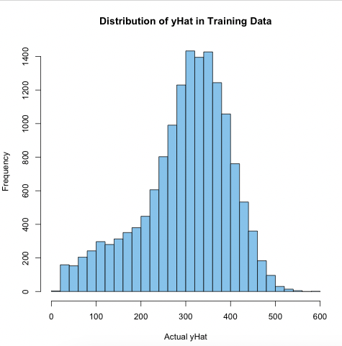
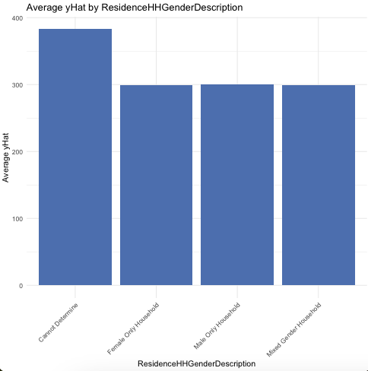
Data Visuals 1 of 4
Notes:
Let’s get into reviewing the training data, first up on the left we have a histogram to represent the revenue by frequency. This is a nice distribution peaking roughly in the middle and very gaussian. Something that's obvious but not always conspicuous is the fact that this data represents loyal customers who made a purchase, so when it comes to applying this on prospect data we are going to miss the info / features that make up who is likely to not be a customer of BBY, which means we are already going to have some error on that front.
Next up, On the right, we have Gender composition of the HH's and how the revenue averages vary by that. Vey even distribution and a lot of unknowns underscore this data set.

Slide 6
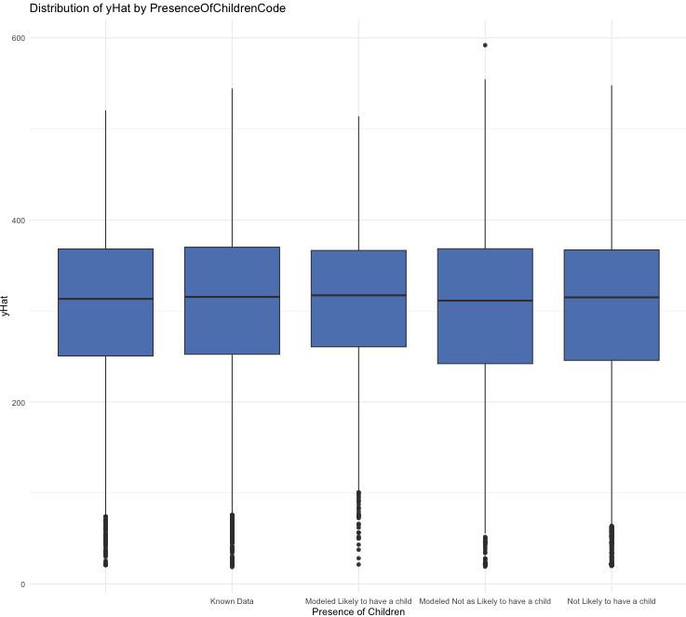
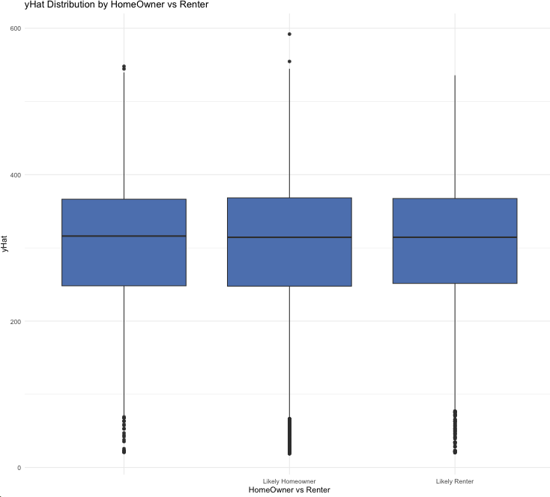
Data Visuals 2 of 4
Notes:
Moving on, on the left we have box plot of revenue by presence of children, again very evenly distributed. and on the right we have boxplot of HomeOwner vs renter against average revenue. Clearly again nothing much to infer here as the data is very evenly distributed, making these variables also low predictors (atleast on their own).
Something else to call is that most features have a lot of Unknowns or blank values which will means that the data needs some treatments / standardizations before it could be used for modeling purposes.

Slide 7
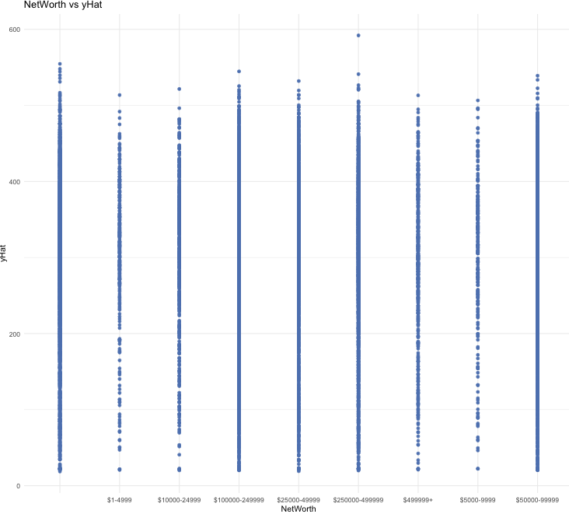
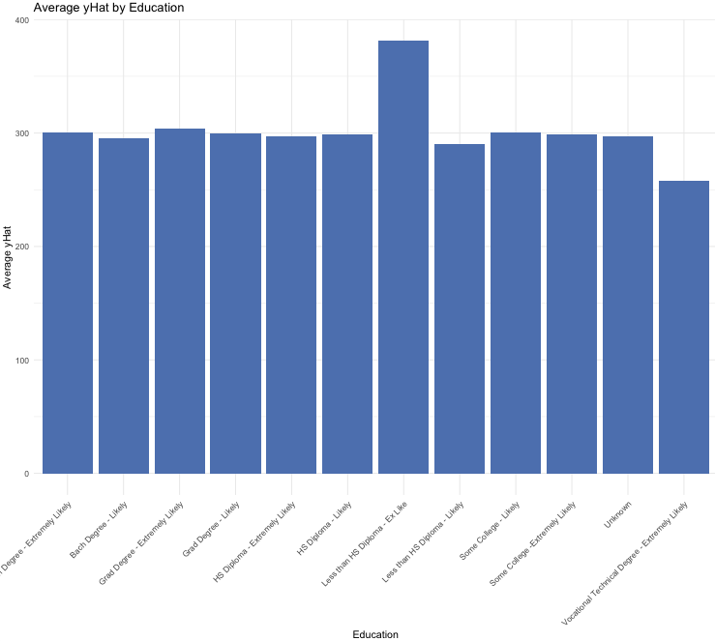
Data Visuals 3 of 4
Notes:
Scatter plot on the left shows networth buckets and the spread of revenue along the buckets.
Barchart on the right shows Education levels and the corresponding of the average revenue for each education level
Recurring theme, even distribution of data, exception is one education category which shows a higher than average revenue than rest of categories.

Slide 8
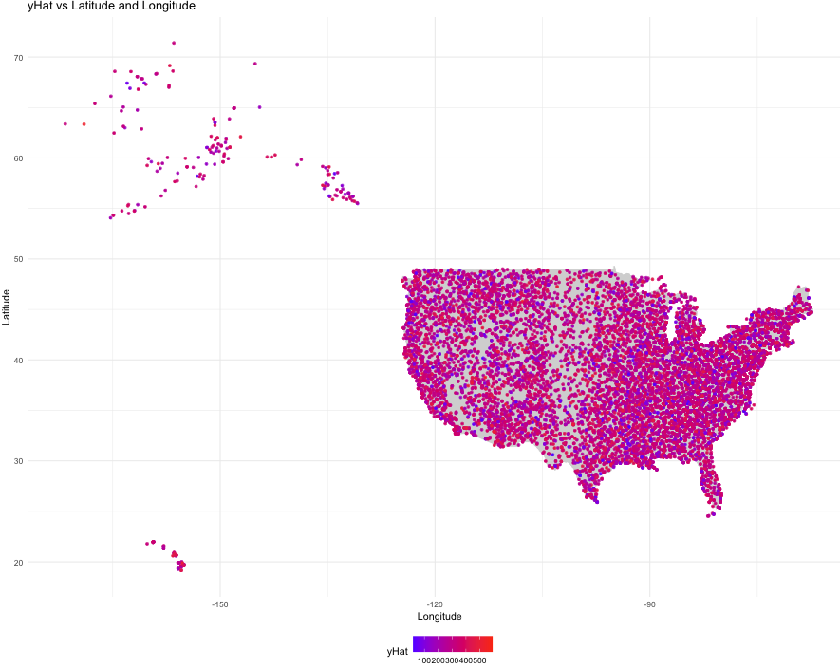
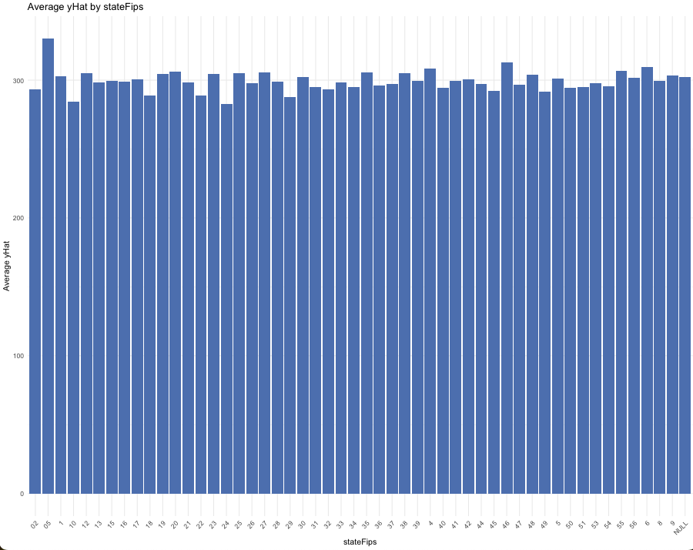
Data Visuals 4 of 4
Notes:
Lastly let review the data on a map, highly evenly distributed across all states of usa and with color scheme of blue (low revenue) to red (high Revenue)
Reviewing the revenue distribution using STATEFIPS , which are standardized codes representing the 50 something states of usa, on a bar chart we find backing for our inference from the map.

Slide 9
First Fit
Treat the input data (vtreat library) and do a first fit using all variables from vtreat output,
Model Metrics (training Only) , all models run with cross validation set to 3
Feature importance Review : Top 10 features from each Model
Linear Model | Random Forest | XGB | GBM
Education_lev_x_Some_College_minus_Extremely_Likely | BroadEthnicGroupings_catP | UpscaleBuyerInHome_catN | UpscaleBuyerInHome_catN
DogOwner_lev_x_ | ISPSA | UpscaleBuyerInHome_catD | UpscaleBuyerInHome_catD
EthnicDescription_catN | BroadEthnicGroupings_catD | UpscaleBuyerInHome_catP | OccupationIndustry_catP
MedianEducationYears | MedianEducationYears | EthnicDescription_catN | BookBuyerInHome_catD
Education_lev_x_HS_Diploma_minus_Likely | EthnicDescription_catP | BroadEthnicGroupings_catP | BroadEthnicGroupings_catP
BookBuyerInHome_lev_x_2_book_purchases_in_home | EthnicDescription_catN | BroadEthnicGroupings_catD | Education_catD
OccupationIndustry_lev_x_Clerical_slash_Office | BroadEthnicGroupings_catN | EthnicDescription_catP | BroadEthnicGroupings_catD
OccupationIndustry_lev_x_Manufacturing | Education_catP | Education_catP | EthnicDescription_catD
OccupationIndustry_lev_x_Financial_Services | EthnicDescription_catD | MosaicZ4_catN | NetWorth_catN
Education_lev_x_HS_Diploma_minus_Extremely_Likely | Education_catD | MedianEducationYears | Education_catP
BookBuyerInHome_catP | Education_catN | Education_lev_x_Bach_Degree_minus_Extremely_Likely | EthnicDescription_catN
---- | ---- | ---- | -----
Notes:
I have used Vtreat library in R to standardize my input data as a one step solution to avoid manual imputation and other decisions.
Models used in my first fit are Linear Reg, Random Forest, Gradient Boosting and XG Boost. Given the nature of the data being evenly distributed, to avoid overfit problems, I have also used cross validation into 3pools across all the 4 fits.
For this first iteration, I decided to let the models use all the variables in treated input set as I am trying to assess most useful features in predicting revenue and then in establishing a baseline for my error metrics which ideally, we want to improve them in the final model.
Low R2 and RMSE in the high 90's underscore these initial models.
VarImp Function in caret package was used to retrieve the top 20 variables of each model and the second table on the slide shows top 10 only but the point here is to build a parsimonious model considering the most relevant features

Slide 10
Feature Engineering
Summary of the feature engineering performed
Included Variables
AnyDonation (Binary Indicator):
Indicates whether a person has made any donation across multiple categories (e.g., environment, healthcare, veterans).
HighSpenders (Binary Indicator):
identifies high spenders, based on whether individuals buy upscale items (e.g., antiques, art) or collect general items. It is marked as 1 if any of these conditions are true and 0 otherwise.
OccupationRebinned (Re-categorized Occupation Industry):
Re-binned occupation industry categories into broader groups such as Professional, Service-Oriented, Leadership/Management, Healthcare, and Other to reduces the complexity / cardinality of the original occupation categories,
HasPet (Binary Indicator):
Consolidated pet ownership data (horse, cat, dog, or other pet) into a single binary feature
MagazineSubscriptionCount (Continuous Variable):
A new continuous feature that counts the number of magazine subscriptions a person has, based on several magazine-related categories.
"Education_lev_x_Some_College_minus_Extremely_Likely", "DogOwner_lev_x_", "EthnicDescription_catN", "MedianEducationYears", "Education_lev_x_HS_Diploma_minus_Likely", "BookBuyerInHome_lev_x_2_book_purchases_in_home", "OccupationIndustry_lev_x_Clerical_slash_Office", "OccupationIndustry_lev_x_Manufacturing", "OccupationIndustry_lev_x_Financial_Services", "Education_lev_x_HS_Diploma_minus_Extremely_Likely", "BookBuyerInHome_catP", "BookBuyerInHome_lev_x_", "BookBuyerInHome_lev_x_1_book_purchase_in_home_", "OccupationIndustry_lev_x_Skilled_Trades", "OccupationIndustry_lev_x_Medical", "OccupationIndustry_lev_x_Management", "OccupationIndustry_lev_x_Unknown", "OccupationIndustry_catP", "OccupationIndustry_lev_x_Other", "OccupationIndustry_lev_x_Education", "BroadEthnicGroupings_catP", "ISPSA", "BroadEthnicGroupings_catD", "EthnicDescription_catP", "BroadEthnicGroupings_catN", "Education_catP", "EthnicDescription_catD", "Education_catD", "Education_catN", "NetWorth_catN", "OccupationIndustry_catD", "NetWorth_catP", "OccupationIndustry_catN", "NetWorth_catD", "BookBuyerInHome_catD", "BookBuyerInHome_catN", "PresenceOfChildrenCode_catN", "UpscaleBuyerInHome_catN", "UpscaleBuyerInHome_catD", "UpscaleBuyerInHome_
Above list derived based on importance (p-value) for each model and the remaining variables are all excluded from the refit.
46 variables retained, 5 variables engineered, and 57 variables excluded
Notes:
Before deducing what features to use for feature engineering, I made a unique list of all the important features identified by the 4 models. This a list of 46 variables shown on the right-hand slide of the slide ..
Not surprisingly, Occupation, Education level, Consumer purchase behavior, ethnicity related attributes were among the top-most useful features…
and I must say I did not see any problems in using these from an ethical standpoint as there were no religious or political views among these..
Before discarding the rest, I decided to create some consolidated variables that could represent the essence of a lot of individual variables which we plan to drop. On the left of the slide, some binary features and other efforts of feature engineering..
I then proceeded to drop all other features (57 variables)

Slide 11

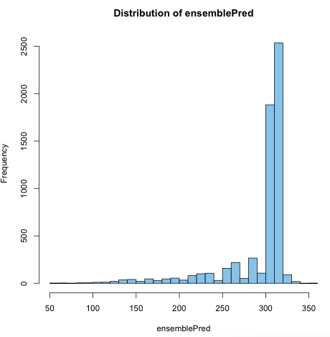
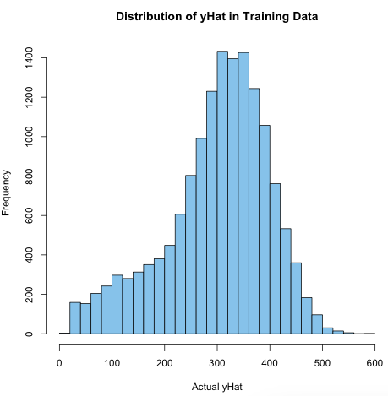
Parsimonious Model
Results Training vs Validation
How did Models perform ? Random Forest model did not show the necessary stability expected for a good model [as training vs testing metrics vary over 10% ]
Low R2 Acceptable ? Although other 3 models show stability from Training to testing set, their R2 is lower than usual. The data is actual consumer data that has been randomized, so a higher RMSE and lower R-squared is to be expected in a way.
Final Prediction Model Recommended: Ensemble Average prediction from remaining 3 models to reduce the % error in prediction using multiple models
Notes:
all 4 algorithms used in my first fit ]( Linear Reg, Random Forest, Gradient Boosting and XG Boost) were applied again on the subset.
Results of this iteration, my R2 is comparable to my initial fit which confirms that we did not loose any significant features. The RMSE and other error metrics have gone down slightly confirming that the features engineering and removal of noisy features helped the model get more accurate.
And 3 of the 4 models (except rf) shows stability between training and testing
Low R2 cannot be improved given the data is anonymized and we cant join to external data except reference data or other economic data by geographical features etc.
As Random forest does not show stability, its omitted in my Final prediction which is an ensemble average between the other 3 remaining models to further reduce error. Reviewing the distribution of this prediction of revenue, we notice a very right skewed distribution compared to the training data set. I ll come back to this point in my final recommendations.

Slide 12
Model validity ?
(error range acceptable )
Segmentation of customers ?
High / Med / Low
Revenue by region ?
Who are the Top prospects?
(Personas)
What Insights may benefit Marketing ?
increase transactions ?
Revenue for a period vs lifetime?
Increase Loyal customers population ?
Who are targets for upsell Opportunities ?
Revenue by Season / purchase timing
Who are targets for Cross Sell Opportunities ?
Notes:
When it comes to deriving insights and using it for strategy, there are a lot of use cases / problems that business might be interested in solving in which data analytics could come in handy
Some of those are on this slide.
However, in interest of the case prompt, lets focus on the Best customers : Criteria used here to define best customer is top 100 customers by revenue among the prospects.

Slide 13
Review of Top Prospects
Adjoining Table is just a small portion of top 5 prospects by their revenue estimates.
Many of these features exhibit the same or similar values across the top 100 prospects data
This allows us to define the persona of a potential top prospect
DogOwner_lev_x_Yes:
Most cases the value is 1
EthnicDescription_catN:
Commonly has the value Other across many rows.
MedianEducationYears:
Values are consistently greater than 14
PresenceOfChildrenCode Variables:
Mostly 0, indicating absence of children in the household.
UpscaleBuyerInHome Variables:
Commonly marked with values like 0 for both catN and catD
Notes:
Based on the definition of the best customers, we can further analyze the features that are common across top 100 customers and the table is a glimpse of top 5 and some features that are highly relevant.
This analysis helps us define the persona of this top customer household which in this case is roughly something like a "Dog Owning, other ethnicity family with a median education years of 14 or more with no children and no upscale buyers at home...."

Slide 14
What Next
Tune hyperparameters or try alternative ensemble methods if error is to be decreased further
Review other segments of prospects and their behavioral features in comparison to top prospects
Tailor Marketing campaigns based on segments
If real data behind was available, look to enrich data to improve R2
Perform cost benefit analysis of implementing any marketing strategy based on these models
Define steps for model deployment & define monitoring tools to track model performance in production
Review the model to ensure that it doesn’t introduce / amplify bias and that its fair from ethical view-point ( free from using features such as political affiliations which could be controversial)
Notes:
Finally, I leave a few recommendation on potential next steps from here .. a couple that standout are
making sure there is a well distributed prospects across the segments (perhaps Low / Med / High by Revenue) and then creating tailored marketing campaigns based on segmentation …
Performing some cost benefit analysis of implementing any marketing strategy to assess potential upside vs downside of the strategy before making an informed decision.

Slide 15

Thank You
Notes:
Thank you to all my audience and I hope you found this presentation logical and useful in taking your ideas a step further into the world of ML / analytics..

